Slide 1
JavaScript – jQuery
Instructor: Manu Peethambar
E-mail: cm13055@umbc.edu
Telegram handle: @manupeethambar888
Slides: https://github.com/manupeethambar888/webdev

Slide 2
jQuery Introduction
The purpose of jQuery is to make it much easier to use JavaScript on your website.
https://www.w3schools.com/jquery/jquery_intro.asp
https://www.w3schools.com/jquery/jquery_get_started.asp
jQuery Syntax
The jQuery syntax is tailor-made for selecting HTML elements and performing some action on the element(s).
https://www.w3schools.com/jquery/jquery_syntax.asp

Slide 3
jQuery Selectors
jQuery selectors are one of the most important parts of the jQuery library.
https://www.w3schools.com/jquery/jquery_selectors.asp
jQuery Event Methods
jQuery is tailor-made to respond to events in an HTML page.
All the different visitor's actions that a web page can respond to are called events.
https://www.w3schools.com/jquery/jquery_events.asp

Slide 4
jQuery Effects - Hide and Show
With jQuery, you can hide and show HTML elements with the hide() and show() methods.
https://www.w3schools.com/jquery/jquery_hide_show.asp
jQuery Effects - Fading
With jQuery you can fade elements in and out of visibility.
https://www.w3schools.com/jquery/jquery_fade.asp

Slide 5
Assignment 17 due – 7/19/2018
Create a sample html file.
Go to the next slide for the question.
Save this as “assignment17.html” in Homework folder in your GitHub repository “Assignments_yourname”.
Commit and push the changes to the repository.

Slide 6
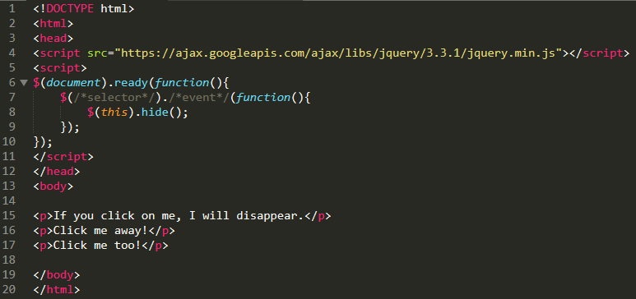
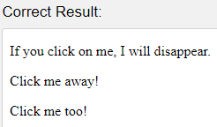
Assignment 17 due – 7/19/2018
If you click on a <p> element, it should be hidden. Use the correct SELECTOR and EVENT to do so.

Slide 7
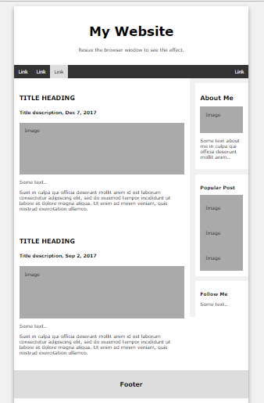
Project Assignment
You have to save the below assignment in your project folder.
Replace the text and fill your relevant information into the elements in index.html
Add relevant images.

